Slide 1

Program Management Consultancy for Business Transformation
BSES Rajdhani Power Limited and BSES Yamuna Power Limited
July 2021

Slide 2
Scope of Services
Engagement Overview – Key Workstreams
Part of Project “Josh” - An organization wide Business Transformation initiative
Six major workstreams of the engagement – Support in strategy formulation, followed by PMO support for nine months in 3 areas
06
01
Reducing past regulatory overhang
EBITDA Improvement
05
02
Digital transformation of discoms
Technology Roadmap
Digital Platform Play
Customer Perception
04
03

Slide 3
Scope of Services
Pillar 1: EBITDA improvement
Diagnostic Review and Action Plan (First 3 months)
Project Monitoring and Implementation Support (Following 9 months)
Deliverables
Activities
Diagnostic Review and action plan report
Review of power purchase cost and optimization
Disallowance of power purchase cost related aspects
Enhancing efficiency of capital investments
Review and analysis of existing PPAs and contractual commitments
Review of RPO compliance
Impact of renewable integration
Potential deficits arising due to expiry of high cost PPAs
Review of power purchase scheduling
Reasons for penalties due to RPO Non-compliance
Process for capex planning, project management and prioritization of capex schemes
Smart meter and IoT rollout & review of vendor master list
Optimization of working capital cycles
Various periodic deliverables during PMO phase
O&M cost analysis and optimization
Loss Reduction
Financial Cost Management
Achievement of quantified outcomes/milestones for each area
R&M costs review – Process review for optimization and workflow standardization
A&G costs – Review of existing functional costs
Advanced analytics for loss reduction interventions
Development of action plan for overachievement of AT&C loss targets
Working Capital Management Cycle and application of funds
Business seasonal and cyclical impact on cash flow

Slide 4
Scope of Services
Pillar 1: EBITDA improvement
Diagnostic Review and Action Plan (First 3 months)
Project Monitoring and Implementation Support (Following 9 months)
Continued analysis and SME support
Preparation of an integration plan of identified initiatives
Project Management Office
L2/L3 level granular tracking and monitoring of interventions
Identification of implementation risks and development of mitigation plans
Weekly discom Dashboard on key interventions
Strategy Phase
PMO Phase
Workstream/ activity | M1 | M2 | M3 | M4 | M5 | M6 | M7 | M8 | M9 | M9 | M10 | M11 | M12
EBITDA Improvement
Diagnostic Review and action plan
Project Monitoring and Implementation Support

Slide 5
Scope of Services
Pillar 2: Technology Roadmap
Deliverables
Activities
Existing business processes
Future business requirements
IT Infrastructure
Understand existing business processes, operations and technology footprint across operations, investment, customer and other business processes
Understand future business requirements and key pain points/issues
Review of IT Infrastructure architecture, utilization trends, IT Infrastructure monitoring, management tools
Review of current IT systems and recommendation of ways to enhance benefits from various technologies
Existing Operating Model
Business Continuity Plan
Opportunities for improvement
Review of existing IT Operating Model
Review of business continuity plan and technology architecture.
Identify key gaps and observations
Identify opportunities for improvements, standardization and optimization and propose prioritizing and phasing of investment needs
Strategy Phase
PMO Phase
Workstream/ activity | M1 | M2 | M3 | M4 | M5 | M6 | M7 | M8 | M9 | M9 | M10 | M11 | M12
Technology Roadmap
Diagnostic Review and action plan

Slide 6
Scope of Services
Pillar 3: Customer Experience Improvement
Deliverables
Activities
Enhancing engagement level
As-is digital and mobility services
Benchmarking customer service
Strategy for enhancing engagement level with different customer segments
Review of as-is digital and mobility services offered to customers and recommend to-be
Benchmarking of customer service offering with peer discoms
Customer experience and perception management/branding
Perception Management
Branding Strategy
Consumer Record Management
Perception management for different consumer segments
Branding strategy with value engagement with consumer groups, RWAs, NGOs and other key/VVIP consumer stakeholders
Review of consumer record management, digitalization and real time opportunities
Strategy Phase
PMO Phase
Workstream/ activity
Customer experience management
Diagnostic Review and action plan

Slide 7
Scope of Services
Pillar 4: Digital Platform Play
Deliverables
Activities
Potential platform opportunity exploration report
Platform opportunity exploration
Platform Strategy Design
Platform’s Digital Blueprint
Identifying ecosystems and arena
Scanning the ecosystem and crystalizing key components
Identifying leverageable assets and moats
Choosing the arena to focus
Identifying value chains and platformization space
Analyzing potential to exchange value
Identifying elementary transaction
Assembling platform experiences
Potential business models
Preparing use case catalogue
Digital tools/tech architecture
Platform Strategy Design & Value proposition report
Digital blueprint and technology building blocks
Strategy Phase
PMO Phase
Workstream/ activity | M1 | M2 | M3 | M4 | M5 | M6 | M7 | M8 | M9 | M9 | M10 | M11 | M12
Digital Platform Play
Diagnostic Review and action plan

Slide 8
Scope of Services
Pillar 5: Digital transformation of discom operations
Deliverables
Activities
Note on key business challenges/use cases across identified functions
Business challenge assessment
Understanding of other utilities
Mapping existing landscape
Assess function-wise (mainly power procurement, asset management, operations and maintenance, MBC, customer services and safety) business challenges and use cases
Bring in understanding and knowledge of various leading Indian and Global utilities around use of technology to identify digital interventions to transform BRPL/ BYPL into a utility of the future
Map existing OT, digital and IT landscape of BRPL/ BYPL and its migration over wave 1
Report on shortlisted digital interventions and new business opportunities
Recommendation of opportunities
Assessment of digital interventions
Implementation roadmap
Implementation roadmap (wave 1 over the next 18 months)
Identify and recommend technology based extended business opportunities suitable for utilities to enhance their overall enterprise value
Assess and prioritize digital interventions based on value creation, resource requirement, ease of implementation, regulatory challenges, timelines for implementation etc.
Develop an implementation roadmap and project plan for implementing shortlisted Wave 1 digital initiatives and new business opportunities
Strategy Phase
PMO Phase
Workstream/ activity | M1 | M2 | M3 | M4 | M5 | M6 | M7 | M8 | M9 | M9 | M10 | M11 | M12
Digital Transformation of Discom operations
Diagnostic Review and strategic roadmap

Slide 9
Scope of Services
Pillar 6: Reducing past overhang
Deliverables
Activities
Continued analysis and SME support on the overhang issues
Power purchase payables
Accumulation of regulatory assets
Program Management and SME support to discoms
Evaluating options for payout of outstanding Power Purchase dues, along with settlement of LPSC
Financial restructuring and funding of outstanding power purchase liabilities
Analysis and preparation for discussions/negotiations with key stakeholders
Program Management and SME support to discoms
Review of regulatory assets
Categorization of regulatory assets for strategy finalization:
Seeking low cost financing against approved regulatory assets
Support with analysis and preparation in discussions with stakeholders
Support in quantified approval from DERC for regulatory assets
PMO support on other pending cases
L2/L3 level granular tracking and monitoring of interventions
Monthly monitoring report on movements Power Purchase and Regulatory Asset
Strategy Phase
PMO Phase
Workstream/ activity | M1 | M2 | M3 | M4 | M5 | M6 | M7 | M8 | M9 | M9 | M10 | M11 | M12
Reducing past overhang
Assist in working out options for outstanding power purchase payables
Assistance with respect to Regulatory Assets

Slide 10
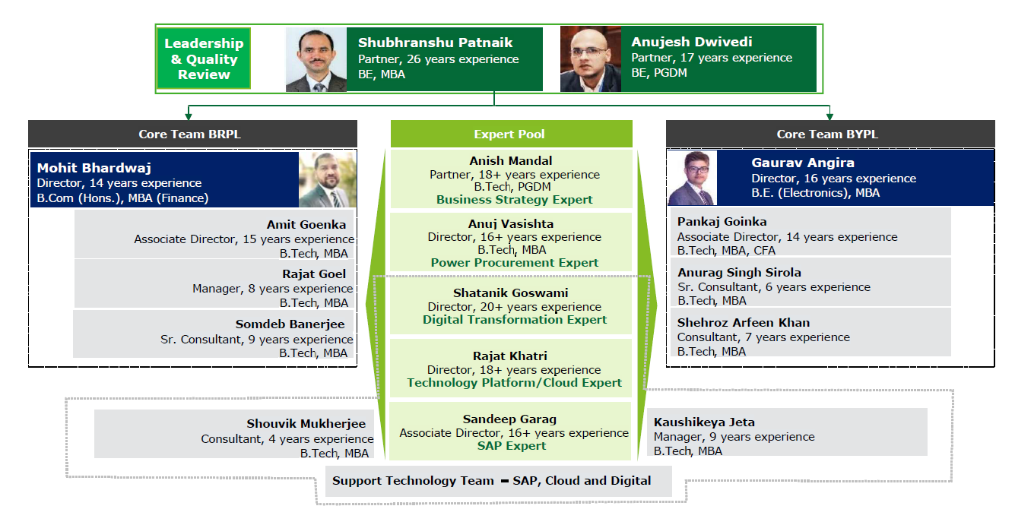
Meet the Team
Team Structure

Slide 11
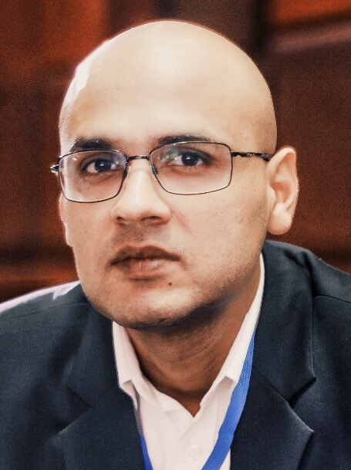
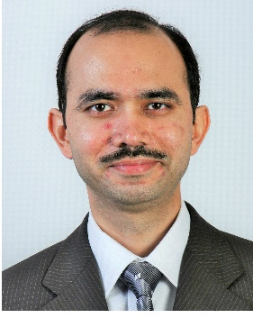


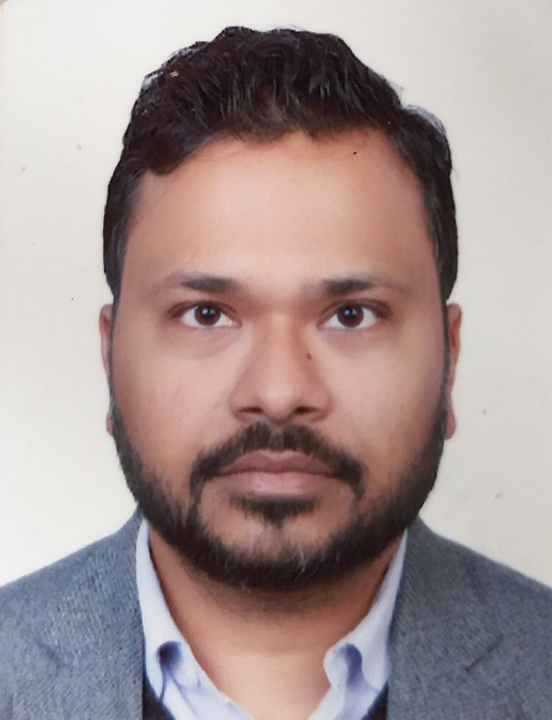
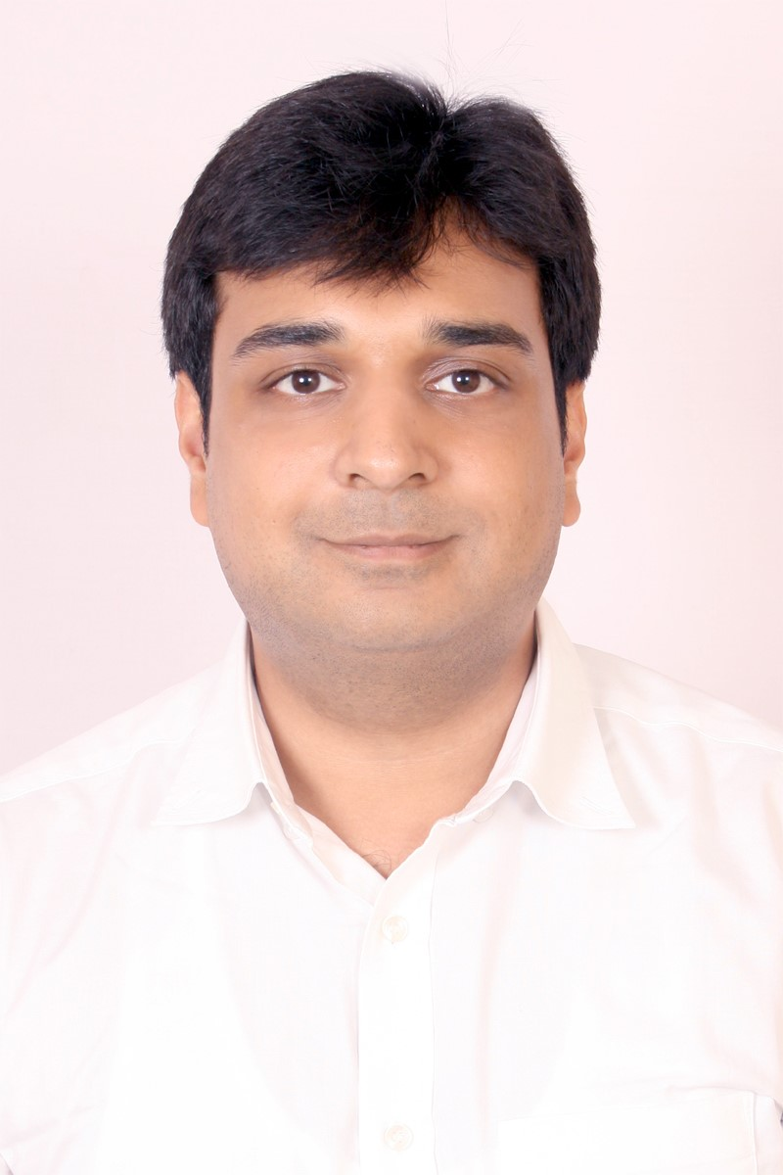
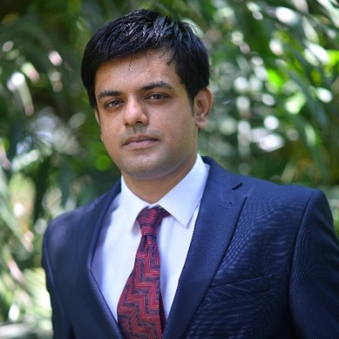




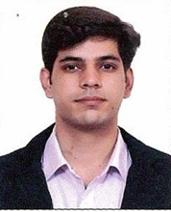
Project Governance Mechanism
Project Governance and Quality Review Committee
Our teaming model involves different project committees to ensure that we bring in high-level expertise to bear while executing this engagement
Anujesh Dwivedi
Partner
Shubhranshu Pattnaik
Partner
Project Management Committee
Mohit Bhardwaj
Director
Gaurav Angira
Director
Project Execution Team (BRPL)
Project Execution Team (BYPL)
Amit
Goenka
Associate Director
Rajat
Goel
Manager
Somdeb
Banerjee
Manager
Shouvik
Mukherjee
Senior Consultant
Pankaj
Goinka
Associate Director
Anurag
Sirola
Manager
Kaushikeya
Jeta
Manager
Shehroz
Arfeen Khan
Senior Consultant

Slide 12

Deloitte refers to one or more of Deloitte Touche Tohmatsu Limited, a UK private company limited by guarantee (“DTTL”), its network of member firms, and their related entities. DTTL and each of its member firms are legally separate and independent entities. DTTL (also referred to as “Deloitte Global”) does not provide services to clients. Please see www.deloitte.com/about for a more detailed description of DTTL and its member firms.
This material has been prepared by Deloitte Touche Tohmatsu India LLP (“DTTILLP”), a member of Deloitte Touche Tohmatsu Limited, on a specific request from you and contains proprietary and confidential information. This material may contain information sourced from publicly available information or other third party sources. DTTILLP does not independently verify any such sources and is not responsible for any loss whatsoever caused due to reliance placed on information sourced from such sources. The information contained in this material is intended solely for you. Any disclosure, copying or further distribution of this material or its contents is strictly prohibited.
Nothing in this material creates any contractual relationship between DTTILLP and you. Any mutually binding legal obligationsorrights may only be created between you and DTTILLP upon execution of a legally binding contract. By using this material and any information contained in it, the user accepts this entire notice and terms of use.
©2019 Deloitte Touche Tohmatsu India LLP. Member of Deloitte Touche Tohmatsu Limited
Deloitte Touche Tohmatsu India Private Limited (U74140MH199 5PTC093339), a private company limited by shares, was converted into Deloitte Touche Tohmatsu India LLP, a limited liability partnership (LLP Identification No. AAE-8458),with effect from October 1, 2015.

